Slide 1


EMAIL SPAM DETECTION
By
Avikshith Subudhi (2128015)
Sanjana Mohanty (2128047)

Slide 2
WHAT IS SPAM EMAIL
Spam mails, also known as junk mail or unsolicited commercial email (UCE), are emails sent in bulk to a large number of individuals. They're frequently marketable in nature, promoting products or services, but they can also be used to spread malware or phishing swindles.
SPAM : Unsolicitated commercial emails or junk emails
HAM : Emails that are not spam

Slide 3

PROBLEMS OF SPAM
01
02
PHISHING ATTACKS
MALWARE AND VIRUSES
Scams to trick users.
Malicious software and self-replicating program

Slide 4
04
MACHINE LEARNING ALGORITHMS
K means clustering
05
K- NEAREST NEIGHBOUR
06
Logistic Regression
01
NAIVE BAYES
07
Neural Network
02
08
RANDOM FOREST
Hierarchical clustering
03
SUPPORT VECTOR MACHINE

Slide 5

OUR CODE
01
02
For analysis reference
For User input
Contains
Random forest , SVM , Naive Bayes classifiers
Code contains Naive Bayes Classifier

Slide 6
1. LIBRARIES
2. LOAD AND MODIFY DATASET
## DATASET (LOAD AND MODIFICATION)
# Read the spam collection dataset
data_text <- read.delim("SpamCollection", sep="\t", header=F, colClasses="character", quote="")
# Examine the data structure
SUMMARY(data_text)
# Display the first few rows of the data
head(data_text)
# Extract the column names
colnames(data_text)
# Rename the columns
colnames(data_text) <- c("Class", "Text")
# Convert the "Class" column to a factor with two levels
data_text$Class <- factor(data_text$Class)
# Display the proportion of each class
Prop.table(table(data_text$Class))
# IMPORT NECESSARY LIBRARIES
library(tm)
library(SnowballC)
library(e1071)
library(caret)
library(ggplot2)
library(randomForest)

Slide 7
3.TEXT CLEANING
4. BAG OF WORDS
## BAG OF WORDS
# Create a document-term matrix
dtm = DocumentTermMatrix(corpus)
# Remove sparse terms from the document-term matrix
dtm = removeSparseTerms(dtm, 0.999)
# Display the dimensions of the document-term matrix
dim(dtm)
# Inspect a portion of the document-term matrix
inspect(dtm[40:50, 10:15])
# Define a function to convert counts to binary values
convert_count <- function(x) {
ifelse(x > 0, 1, 0)
}
# Apply the convert_count function to get final training and testing DTMs
datasetNB <- apply(dtm, 2, convert_count)
# Convert the document-term matrix to a data frame
dataset = as.data.frame(as.matrix(datasetNB))
## TEXT CLEANING
# Clean the texts
corpus = VCorpus(VectorSource(data_text$Text))
# Convert all text to lowercase
corpus = tm_map(corpus, content_transformer(tolower))
# Remove numbers from the text
corpus = tm_map(corpus, removeNumbers)
# Remove punctuation from the text
corpus = tm_map(corpus, removePunctuation)
# Remove stop words from the text
corpus = tm_map(corpus, removeWords, stopwords("english"))
# Stem the words in the text
corpus = tm_map(corpus, stemDocument)
# Strip whitespace from the text
corpus = tm_map(corpus, stripWhitespace)

Slide 8
5.VISUALISE FREQUENCY OF WORDS > 100
## VISUALIZE FREQUENCY OF WORDS
# Identify frequently occurring terms
freq <- sort(colSums(as.matrix(dtm)), decreasing = TRUE)
tail(freq, 10)
# Find frequently appearing terms
findFreqTerms(dtm, lowfreq = 60)
# Plot word frequencies
wf <- data.frame(word = names(freq), freq = freq)
head(wf)
pp <- ggplot(subset(wf, freq > 100), aes(x = reorder(word, -freq), y = freq)) +
geom_bar(stat = "identity") +
theme(axis.text.x = element_text(angle = 45, hjust = 1))
# Display the plot
pp

Slide 9
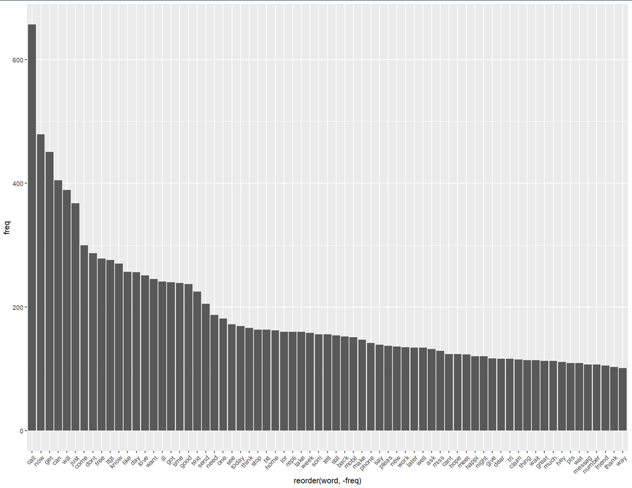

Slide 10
6.SPLIT DATA
## SPLIT DATA
# Add the Class label back to the dataset
dataset$Class = data_text$Class
str(dataset$Class)
# Set the seed for reproducibility
set.seed(222)
# Split the data into training and testing sets
split <- sample(2, nrow(dataset), prob = c(0.75, 0.25), replace = TRUE)
train_set <- dataset[split == 1,]
test_set <- dataset[split == 2,]
# Display the proportion of each class in the training set
prop.table(table(train_set$Class))
# Display the proportion of each class in the testing set
prop.table(table(test_set$Class))

Slide 11
7. FITTING DATA INTO MACHINE LEARNING MODELS
## RANDOM FOREST
# Train a Random forest classifier
rf_classifier = randomForest(x = train_set[-1210], y = train_set$Class, ntree = 300)
# Display the Random forest classifier summary
rf_classifier
# Predicting the Test set results
rf_pred = predict(rf_classifier, newdata = test_set[-1210])
# Evaluate the classifier performance using a confusion matrix
confusionMatrix(table(rf_pred,test_set$Class))
RANDOM FOREST ALGO
## NAIVE BAYES CLASSIFIER
# Create control limit for NB model
control <- trainControl(method="repeatedcv", number=10, repeats=3)
# Train a Naive Bayes classifier
system.time( classifier_nb <- naiveBayes(train_set, train_set$Class, laplace = 1, trControl = control,tuneLength = 7) )
# Make predictions on the testing set
nb_pred = predict(classifier_nb, type = 'class', newdata = test_set)
# Evaluate the classifier performance using a confusion matrix
confusionMatrix(nb_pred,test_set$Class)
NAIVE BAYES CLASSIFIER
## SVM
# Train a support vector machine classifier
svm_classifier <- svm(Class~., data = train_set)
# Display the classifier summary
svm_classifier
# Make predictions on the testing set
svm_pred <- predict(svm_classifier, test_set)
# Evaluate the classifier performance using a confusion matrix
confusionMatrix(svm_pred, test_set$Class)
SUPPORT VECTOR MACHINE

Slide 12



ACCURACY OF MODELS
HERE’S HOW THE DIFFERENT MODELS PERFORMED ON THIS PARTICULAR DATASET. NAIVE BAYES AND RANDOM FOREST WORKED EXCEPTIONALLY WELL BUT SVM DID NOT PERFORM EFFICIENTLY.
100%
99.78%
95%
Random Forest
Naive Bayes
SVM

Slide 13
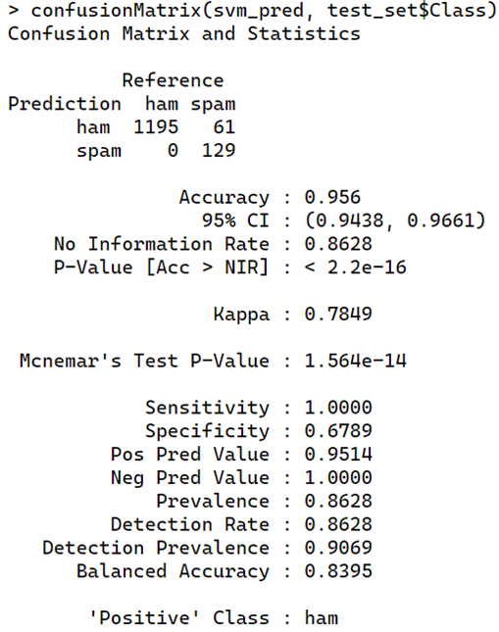
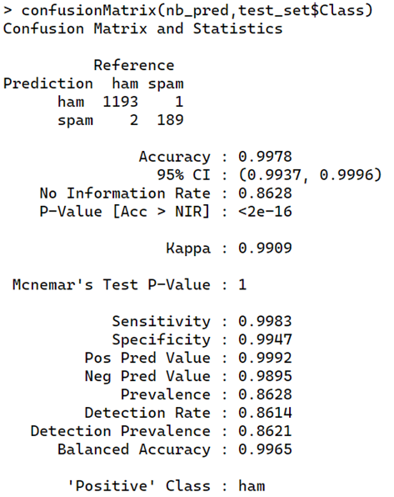
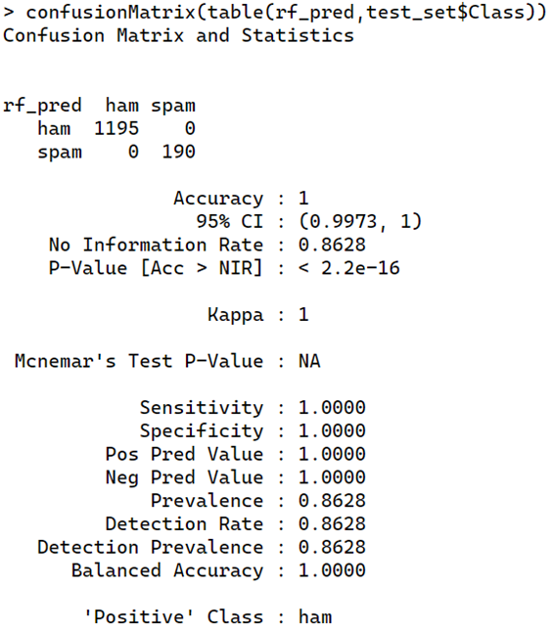
SUPPORT VECTOR MACHINE
NAIVE BAYES CLASSIFIER
RANDOM FOREST

Slide 14

8. USER DATA INPUT AND PREDICTION
## NEW DATA FROM USER (PREDICTION USING NB)
# Get user input for the email to be tested
email_text <- readline(prompt = "Enter the email you want to test: ")
# Create a new data frame for the user input
new_test_set <- data.frame(Text = email_text)
# Clean the user input text
new_corpus <- VCorpus(VectorSource(new_test_set$Text))
new_corpus <- tm_map(new_corpus, content_transformer(tolower))
new_corpus <- tm_map(new_corpus, removeNumbers)
new_corpus <- tm_map(new_corpus, removePunctuation)
new_corpus <- tm_map(new_corpus, removeWords, stopwords("english"))
new_corpus <- tm_map(new_corpus, stemDocument)
new_corpus <- tm_map(new_corpus, stripWhitespace)
# Create a document-term matrix for the user input
new_dtm <- DocumentTermMatrix(new_corpus)
# Convert the new document-term matrix to a data frame
new_test_set <- as.data.frame(as.matrix(new_dtm))
# Make a prediction on the user input
nb_pred <- predict(classifier_nb, type = 'class', newdata = new_test_set)
# Determine and display the spam or not spam message
If (nb_pred == "ham") {
print("This email is likely not spam.")
} else {
print("This email is likely spam.")
}

Slide 15
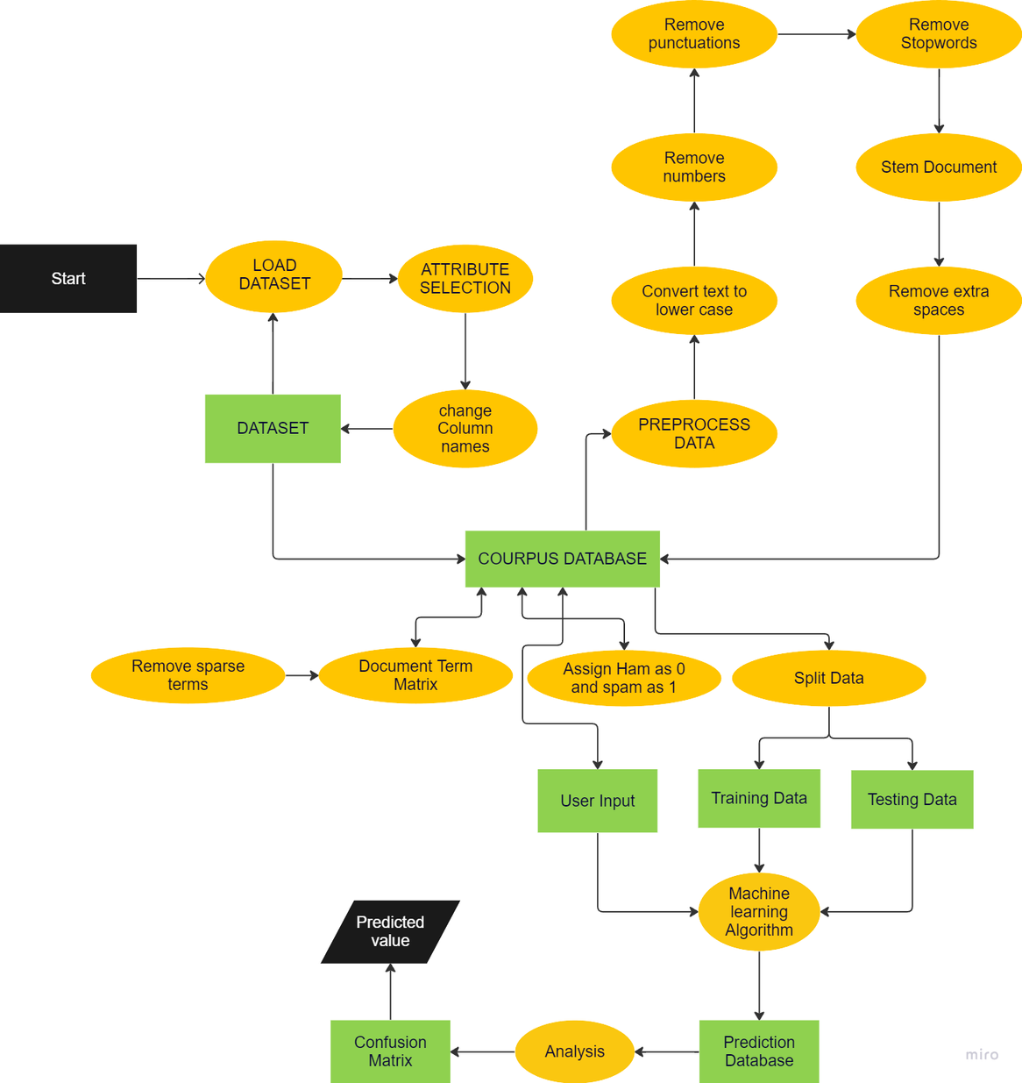

Slide 16

THANKYOU

